Slide 1
SISO Designer
——Control system toolbox
主讲人：郑超
小组成员:葛海康 周煌 赵伟达

Slide 2
Contents
1
The main function of the SISO designer
2
The usage of the SISO designer
3
Design and analysis system
4
System Verification
5
Common command function

Slide 3
The main function
The main function of the SISO：
1、Using the root locus method to calculate the closed-loop characteristics of the system
2、System design for Bode diagram of open loop system
3、Add the zero pole of the compensator；Adjust the amplitude or phase margin of the system
4、Design lead/lag networks and filters
5、Analyze the response of a closed loop system
6、System interchange in continuous or discrete state

Slide 4
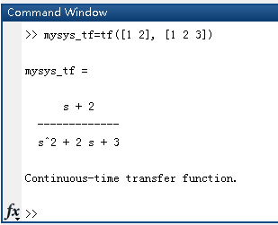
The use
There is an example to illustrate the use of the SISO designer.
we will use the tf command to create LTI（线性时不变系统）
The result is shown in the figure.

Slide 5
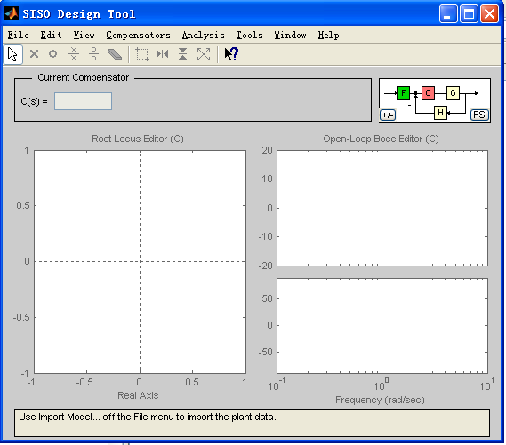
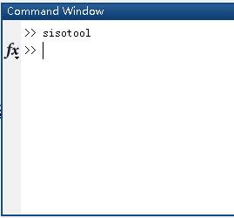
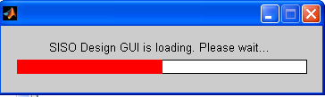
The USE
1、Start the SISO Designer by typing the following command in the MATLAB command window.
3、SISO Design Tool
2、starting

Slide 6
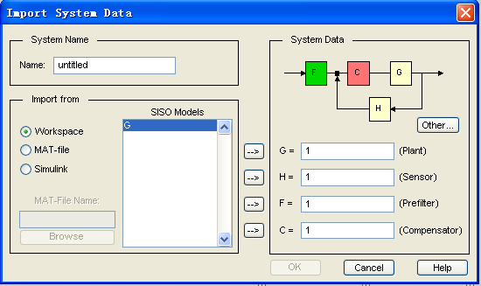
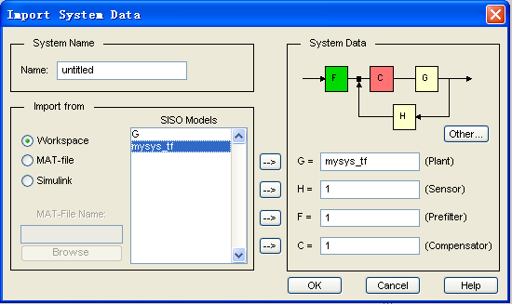
THE USE
4、Import System Data
Set G to mysys_tf
G ：execution structure （执行机构）
H： sensor （传感器）
F： pre-filter （预滤波器）
C： compensator （补偿器）

Slide 7
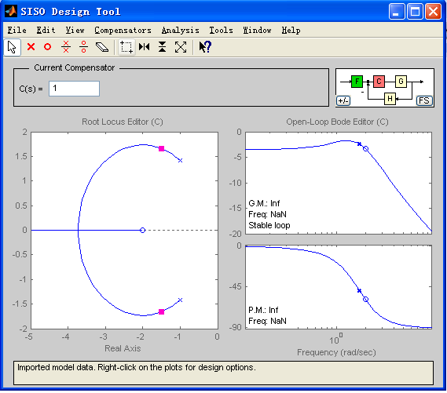
THE USE
5、Get the curve
Blue × and O represent the poles of the control object G
Red represents the poles of the system compensator C
The root trajectory of the system can be controlled and operated in the root trajectory editor: increasing the zero pole of the compensator and moving the zero
pole
These operations can change the dynamic performance of the system.

Slide 8
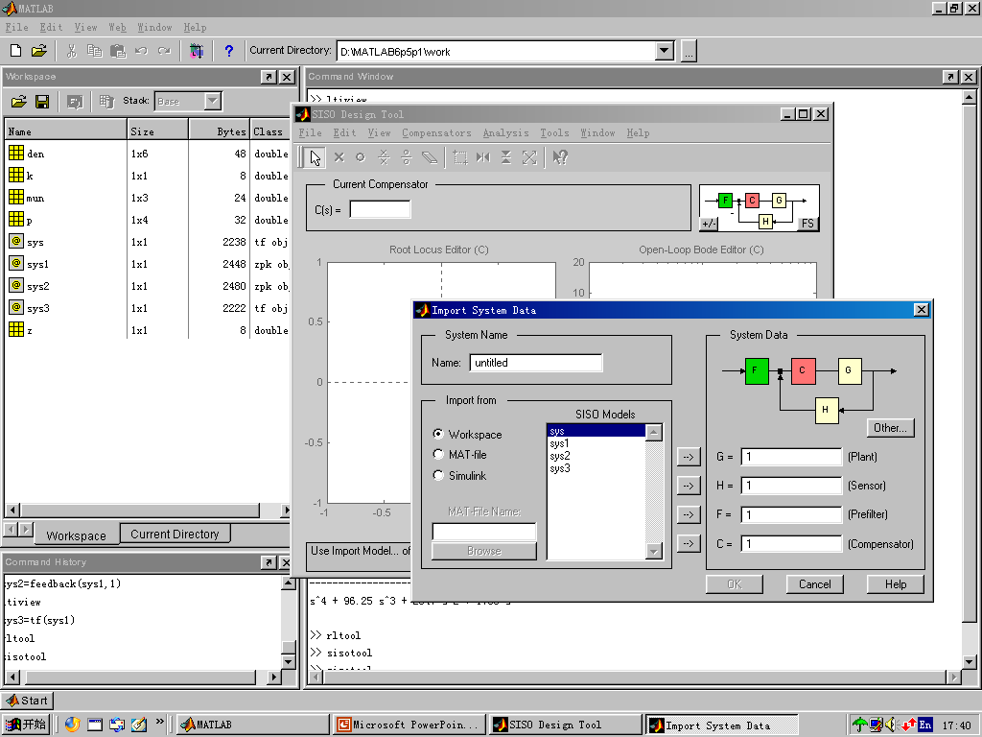
Control system structure
(控制系统结构)
system name
Data source and list
system data
(系统数据)
(系统名称)
(数据源和列表)

Slide 9
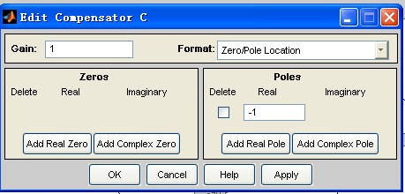
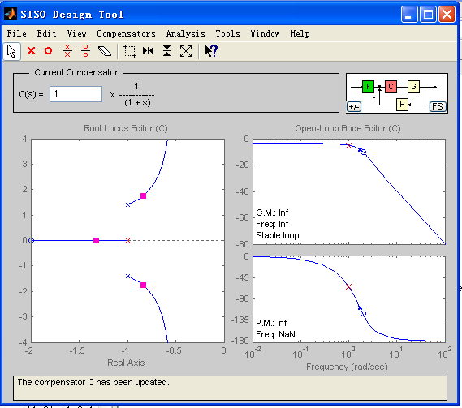
Design
Add a pole to compensator C
The new curve

Slide 10
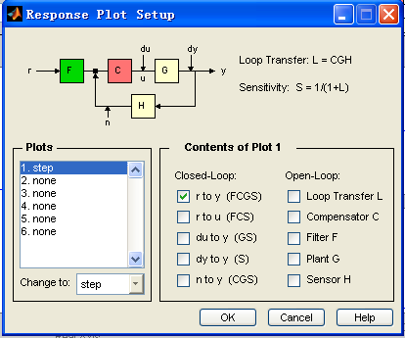
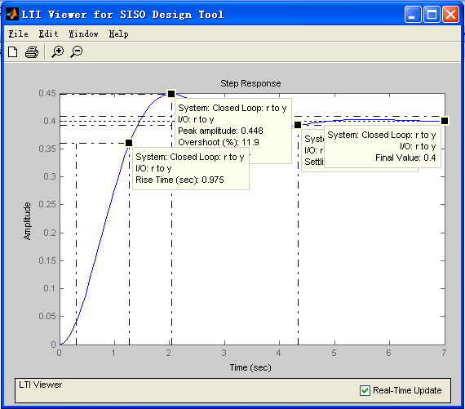
Analysis
Draw a specified curve
After the system design is completed, it needs to be further analyzed: analyze the open loop and closed loop response of the feedback system to ensure that the system meets specific design requirements.
Here, we entered a step response curve.
Analysis curve
Users can analyze system performance such as transition time, peak response, rise time, etc. in the LTI browser.

Slide 11
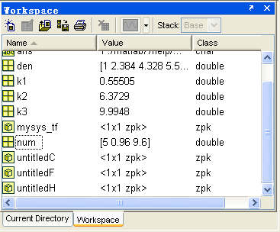
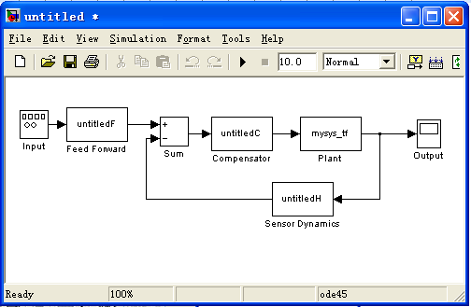
System Verification
● SISO designer integration with Simulink.
1、Save LTI objects into the MATLAB workspace
2、Draw Simulink Diagram

Slide 12
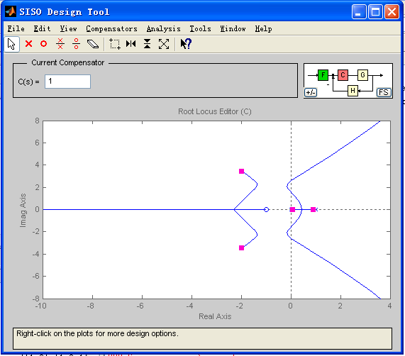
Common command function
rltool(sys):
After the function is executed, the designer of the system model sys root map is opened.
【例】 G（S）=k(s+1)/[s(s-1) (s2+4s+16)]
num=[1 1];den=conv(conv([1 0],[1 -1]),[1 4 16]);
G=tf(num,den);
rltool(G)
The drawing results are shown in the figure：

Slide 13
Thank you

